Slide 1
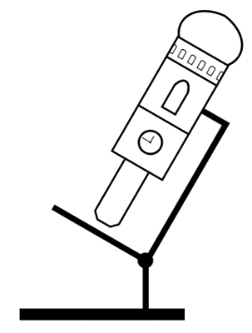

Image processing and presentation
(IPP)
Steffen Dietzel
Ludwig-Maximilians-Universität München
Walter-Brendel-Zentrum für experimentelle Medizin (Wbex) and
Core Facility Bioimaging at the Biomedical Center

Slide 2
Note 1
This presentation contains material for a lecture on Basics of Digital Imaging. It is not a complete lecture (copyrighted material was removed), nor is it suggested that all slides should be shown in a lecture – there is some redundancy. Some slides - like this one - are ‘hidden’ (won’t show in presentation mode).
The ‘notes’ below each slide may contain links to download sources, e.g. for historic portraits, or other information.
File version 2016-July
Notes:
Some slides contain usefull information in this space.

Slide 3
Note 2
This presentation was published on the German BioImaging Website.
http://www.germanbioimaging.org
under
Workgroup 5 Training of facility users
German BioImaging is a network of German microscopists and imaging specialists.
And on the website of the Core Facility Bioimaging at the Biomedical Center (BMC) of the Ludwig-Maximilians-Universität München
http://www.bioimaging.bmc.med.lmu.de/learning-teaching

Slide 4
Copyright notice
Except for the logos or if otherwise noted or where obviously from other sources, material in this presentation was created by Steffen Dietzel.
Material from Steffen Dietzel is distributed under the license ‘Creative Commons Attribution Sharealike‘. This license includes permission to use, alter and redistribute this material (not limited to but including to students and colleagues), provided you give appropriate credit to the creator (e.g. by leaving the copyright notice at the right lower edge of the slide) and you distribute any derivative work under the same license. For license details see http://creativecommons.org/licenses/by-sa/4.0
The logos (lower and upper right corners of the slides, title slide) are not covered by this license. They may be redistributed with the slides provided in this presentation, but not in a different context.
If you should need a different license for your purpose, please contact me at dietzel@lmu.de

Slide 5
How many gray values?
dynamic range, saturation and bit depth

Slide 6
Bit depth of images
1 bit 2 (b/w)
8 bit = 1 byte 256
10 bit 1024
12 bit 4096
13 bit 8192
14 bit 16384
16 bit = 2 byte 65 600
PMTs
CCDs

Slide 7

256 gray values

Slide 8

256 gray values
256 glowscale values

Slide 9

Middle of 256 levels
256 gray levels

Slide 10

100 Gray levels

Slide 11



100 color values

Slide 12
How many gray levels make sense?
For images to look at (no image analysis), 256 gray levels are more than enough.
However, in an 8 bit image they are reached only if the dynamic range is fully used, i.e. the brightest pixel is near 255 and the darkest near 0.
The dynamic range must not be exceeded in original images, i.e. the darkest and brightest gray value must not occur.

Slide 13
How many gray levels make sense?
For images that contain very bright and rather dark structures, 10 bits or more are advantegous. However, these structures cannot be visualized simultaneously very well.

Slide 14
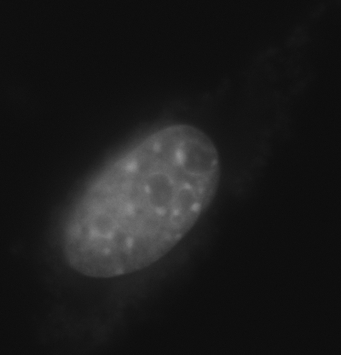
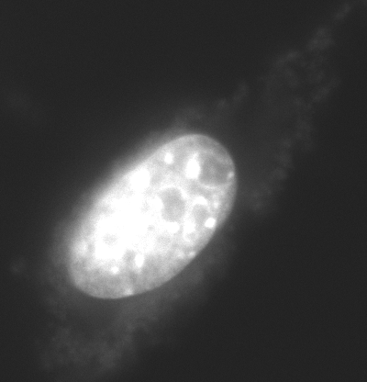
C2C12 myoblast with mycoplasma infection, DAPI staining

Slide 15
How many gray levels make sense?
In automatic recording or time laps recordings, 10 bits or more are advantegous because they allow a safety margin:
Example: when 4096 gray levels are available, set brightest pixel to 2-3000.

Slide 16
Image manipulation: what is allowed, what isn‘t?
Contrast stretching, gamma value, cut and paste, color channels, resizing without recalculating, presentation tricks

Slide 17
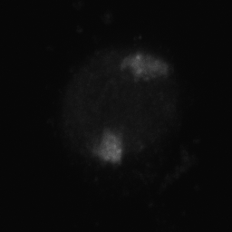
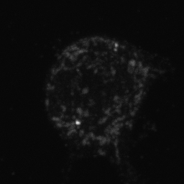
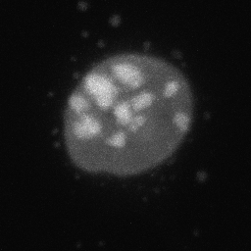
Image Processing and image presentation
Notes:
This example image is a cell nucleus after fluorescence in situ hybridization and confocal microscopy with a painted chromosome territory (left), signals from a BAC clone (center) and DNA counterstain (right).

Slide 18
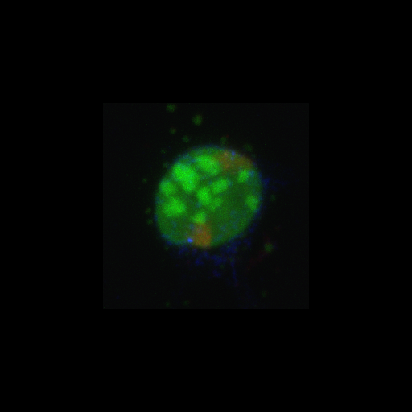
Who cares about the black space around the nucleus?

Slide 19
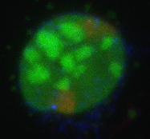
Don‘t use huge bright background with fluorescence images

Slide 20
Don‘t use huge bright background with fluorescence images

Slide 21
Size does matter!

Slide 22
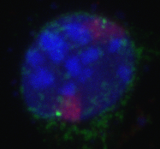

Slide 23
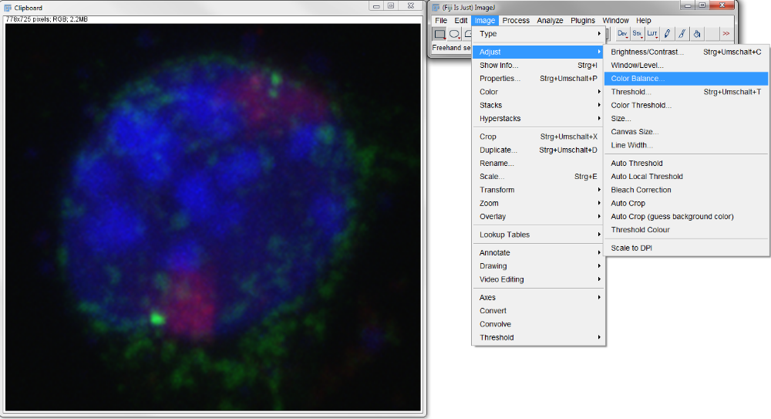

Slide 24
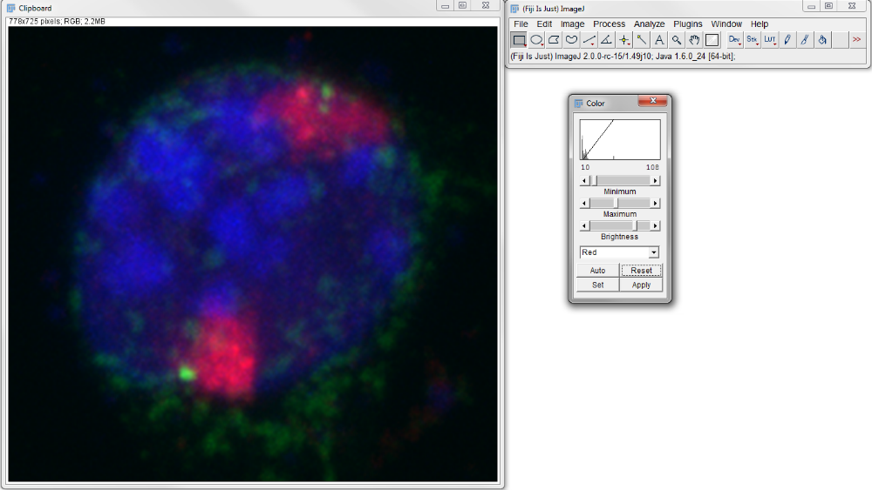

Slide 25
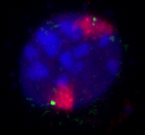
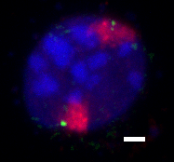
2 µm

Slide 26
JCB author guide lines
The Journal of Cell Biology was one of the first to include imaging guide lines in the ‚Instructions to authors‘.
Suggestion: copy their current version and paste it here, to illustrate what is considered good practice and what not. http://jcb.rupress.org/site/misc/print.xhtml#digim

Slide 27
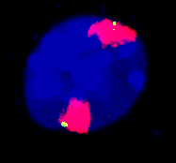
Don‘t overdo it!

Slide 28
Scale bar!
2 µm

Slide 29
How to get a scale bar
From your microscope software, you know the size of one pixel, e.g. 80 nm x 80 nm
Thus, in 10 µm you have 10 µm : 0.08 µm = 125 pixels.
In your image software, draw a box 125 pixels wide (and e.g. 10 px high) for a
10 µm scale bar.

Slide 30
Avoid resampling your image:
With every resampling you loose resolution

Slide 31
Don‘t rotate image with angles other than 90 or 180°

Slide 32
Red and green

Slide 33
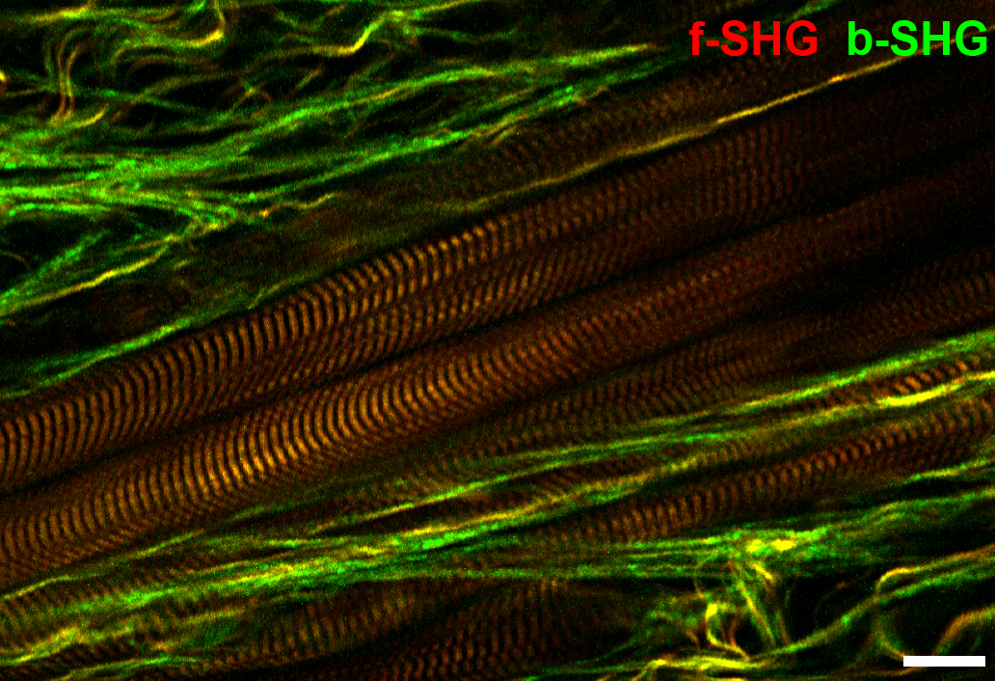
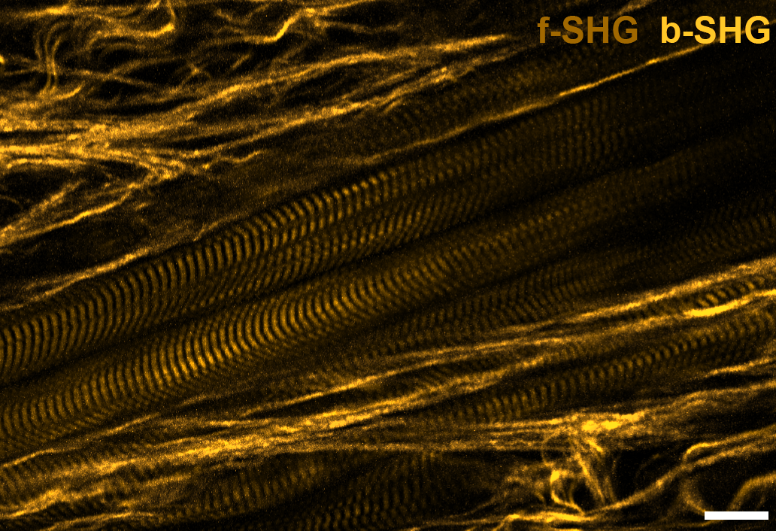
When you show this
8% of all men will see this
(made with the Visicheck plugin, setting ‚deuteranop‘)

Slide 34
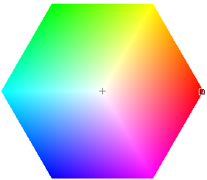
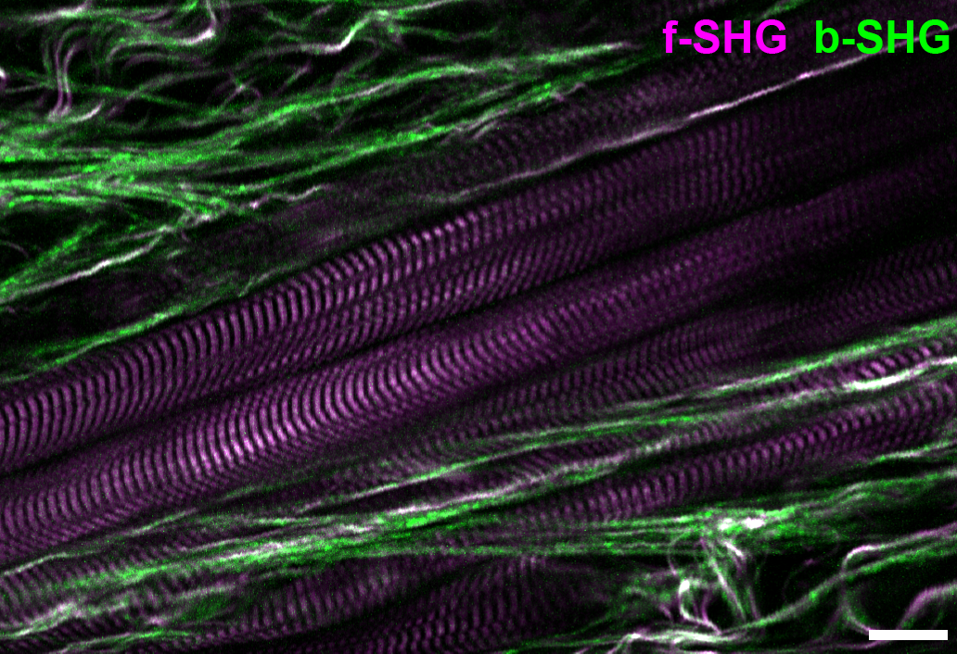
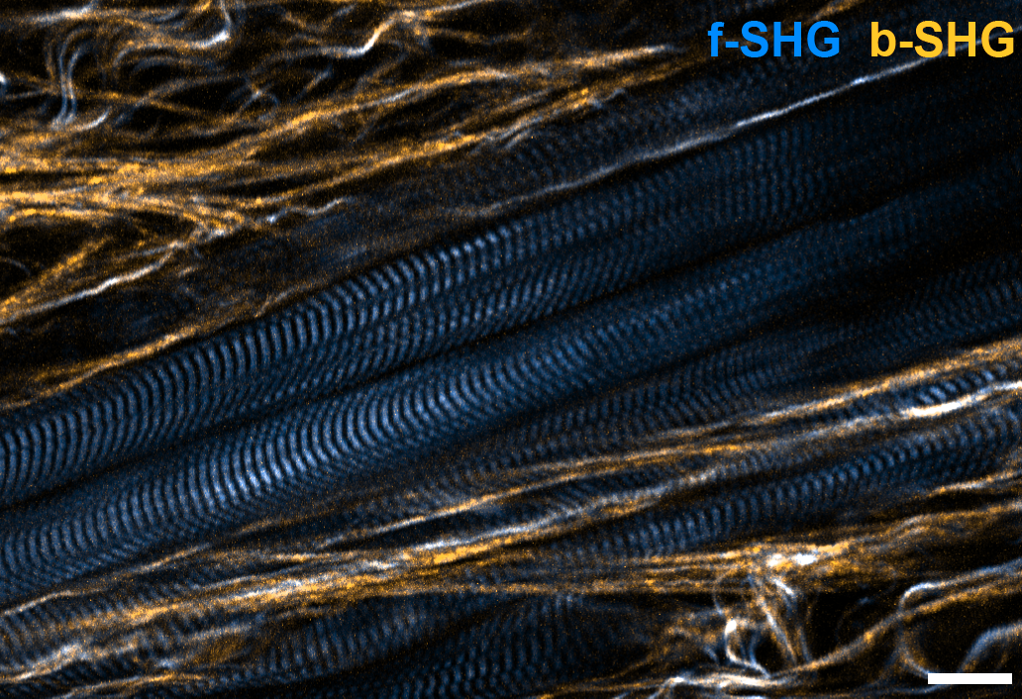
When you show this
8% of all men will see this
(made with the Visicheck plugin, setting ‚deuteranop‘)

Slide 35
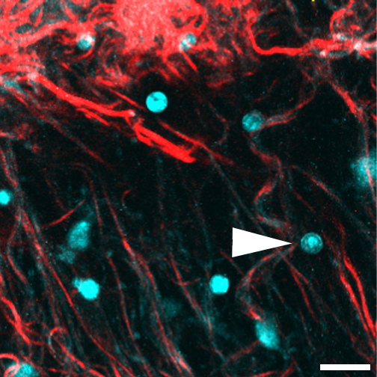
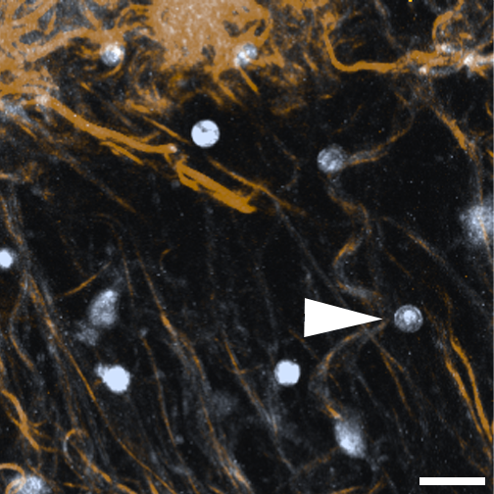
When you show this
8% of all men will see this
(made with the Visicheck plugin, setting ‚deuteranop‘)

Slide 36
Conclusion
If your image contains only two colors, do not use red and green!

Slide 37
Programs for image processing and analysis
free:
Fiji (ImageJ): http://fiji.sc
Irfan View: http://www.irfanview.com/
Gimp: http://www.gimp.org/
Virtual Dub (movie recoding)
Handbrake (coding movies to h264 mp4 or mkv)
commercial:
Amira: http://amira.zib.de/
Photoshop: http://www.adobe.de/
Imaris: http://www.bitplane.com/
Huygens: http:// www.svi.nl

Slide 38
Tasks for Fiji
Adjust brightness/contrast, crop image
RGB image from color channels
Make scale bar
Measure FWHM, beads or filaments, multiple times then average
Rotate an image 8x 45° (or similar) and compare result with original. How to if you have to rotate?
Projections and 3D-rotations in Fiji, make rotation-movie
‚Forbidden‘: cut, paste and combine, show how to reveal the manipulation

