Slide 1
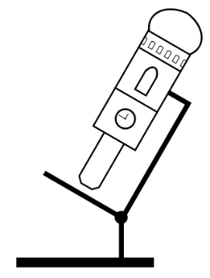

Basics of Digital Imaging
(BDI)
Steffen Dietzel
Ludwig-Maximilians-Universität München
Walter-Brendel-Zentrum für experimentelle Medizin (Wbex) and
Core Facility Bioimaging at the Biomedical Center

Slide 2
Note 1
This presentation contains material for a lecture on Basics of Digital Imaging. It is not a complete lecture (copyrighted material was removed), nor is it suggested that all slides should be shown in a lecture – there is some redundancy. Some slides - like this one - are ‘hidden’ (won’t show in presentation mode).
The ‘notes’ below each slide may contain links to download sources, e.g. for historic portraits, or other information.
File version 2016-July
Notes:
Some slides contain usefull information in this space.

Slide 3
Note 2
This presentation was published on the German BioImaging Website.
http://www.germanbioimaging.org
under
Workgroup 5 Training of facility users
German BioImaging is a network of German microscopists and imaging specialists.
And on the website of the Core Facility Bioimaging at the Biomedical Center (BMC) of the Ludwig-Maximilians-Universität München
http://www.bioimaging.bmc.med.lmu.de/learning-teaching

Slide 4
Copyright notice
Except for the logos or if otherwise noted or where obviously from other sources, material in this presentation was created by Steffen Dietzel.
Material from Steffen Dietzel is distributed under the license ‘Creative Commons Attribution Sharealike‘. This license includes permission to use, alter and redistribute this material (not limited to but including to students and colleagues), provided you give appropriate credit to the creator (e.g. by leaving the copyright notice at the right lower edge of the slide) and you distribute any derivative work under the same license. For license details see http://creativecommons.org/licenses/by-sa/4.0
The logos (lower and upper right corners of the slides, title slide) are not covered by this license. They may be redistributed with the slides provided in this presentation, but not in a different context.
If you should need a different license for your purpose, please contact me at dietzel@lmu.de

Slide 5
Digital images
A digital image is composed of pixels.
A pixel may have one (gray) or several colors (e.g. red, green, blue).
Each color of a pixel has a given intensity value, called “gray value”, “gray level” or similar.

Slide 6
Pixels and Voxels
A pixel (=picture element) is the element of a digital 2D image
A voxel (= volume pixel) is the element of a digital
3D image

Slide 7
A Pixel Is Not A Little Square,
A Pixel Is Not A Little Square,
A Pixel Is Not A Little Square!
(And a Voxel is Not a Little Cube)
Microsoft Technical Memo 6
Alvy Ray Smith, July 17, 1995. (available online)
“A pixel is a point sample.”
“There are cases where the contributions to a pixel can be modeled … by a little square, but not ever the pixel itself.”

Slide 8
“But the pixels on my CCD camera chip are little squares…”
The recording elements on the chip may be square shaped. But the light intensity that is recorded from all the square‘s surface is represented in just one value.
Thus, although the ‚contributions to the image may be modelled by a square‘, the pixels that build up the image are still point samples.

Slide 9
„Pixel size“
Since a pixel is a point sample, it really has no size.
Whenever we talk about pixel size in microscopy, what we really mean is „pixel distance“.
It may help to imagine this as the distance from the center of one pixel to the center of the next.
(Although strictly speaking a point has no center…)
Despite of the above, „pixel size“ is the established term for the pixel distance and broadly used.

Slide 10
Resolution and “pixel size” in digital images
(Nyquist)

Slide 11
We talked about resolution. But how to capture the resolution on the digital image?
If pixels of an image are spaced 2 µm, obviously the image does not resolve structures with a 200 nm resolution.
Which pixel distance (“pixel size”) do we need to digitally capture the resolution (Rayleigh Criterion) that the microscope provides?

Slide 12
The idealized situation
Unlimited number of photons
Two point-like sources emit the same number of photons (identical intensity)
No other sources in the neighborhood
No spherical aberration, Ri mismatch
No noise

Slide 13

The image of a point is not a point, but an Airy pattern

Slide 14
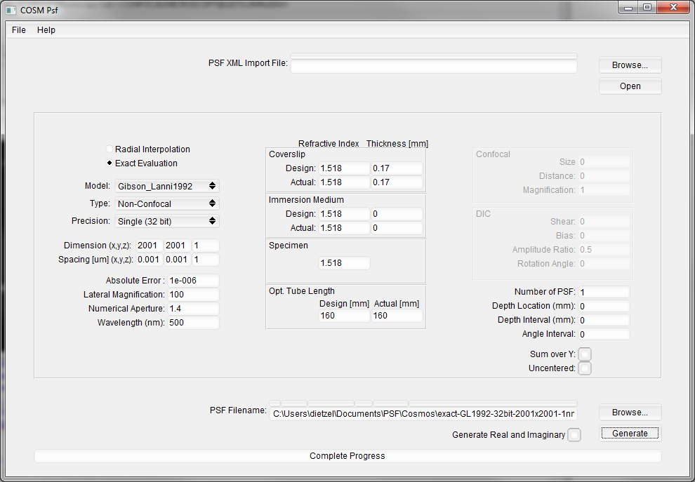
How the Airy patterns and intensity plots in this presentation were created
COSM PSF (http://cirl.memphis.edu/cosmos.php) was used to produce a PSF image (.wu file), see settings in screenshot left. Reassuringly, the first minimum turned out to be at 217 nm away from the Airy pattern maximum, as it should be according to d=0.61*λ/NA.
The .wu image was opened in Fiji (http://fiji.sc/Fiji) using the Import-Raw function with the following parameters: Type 32-real, Offset 1024, Gap 0, Little-endian and the width, height and number of images as defined in COSM PSF.
In Fiji, the image’s type was changed to 16 bit and it was then saved as Text-Image to be reopened in Excel 2013. In the 2001x2001 pixel image, the position of the maximum gray value of 65535 was labeled in Fiji position 1001;1001 and in Excel in Line 1002, Column ALN.
The numbers of line 1002 were then used to draw the “wide-field” diagrams (blue) in GraphPad Prism. For the confocal-with-closed-pinhole diagram (green), the numbers of this line were squared.
For import in Powerpoint, images of Airy patterns in Fiji were first adjusted to the desired grayscale range and then converted to 8-bit,
For images with the ‘added pixel intensities’ (see right), 80x80 pixel (=nm) sized boxes were defined in Fiji (y-value for all: 961. x-values: 961, 1041, 1121, 1201, 938, 1018, 1098, 1178). Two images were added using the “Calculator Plus” (k1=0.5; k2=0). All 12 ‘pixel-’images were combined in a stack to create the montage shown here. The average intensity was determined using the ‘measure’ command. Values were normalized in Excel.
One exception applies: The image with two neighboring Airy patterns was created by Katharina Nekolla with Matlab code kindly provided by Peng Xi. This code is published in his book “Optical Nanoscopy and Novel Microscopy Techniques" published by CRC.
I would like to thank the contributors to the ‘confocal list’ (http://lists.umn.edu/cgi-bin/wa?A0=CONFOCALMICROSCOPY). Without the tips of Arne Seitz, Sergey Tauger, David Baddeley, Peng Xi and others, I would have not been able to generate those images.

Slide 15
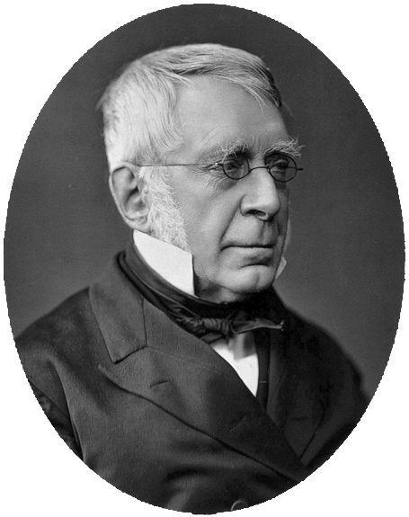
The image of a point is not a point, but an Airy pattern
Sir George Biddell Airy,
27.07.1801–02.01.1892
Astronomer Royal 1835-1881
Notes:
Source of photography: http://wellcomeimages.org/indexplus/image/V0025959.html
Via https://commons.wikimedia.org/wiki/File:George_Biddell_Airy2.jpg

Slide 16
Intensity profile
measured along this line

Slide 17
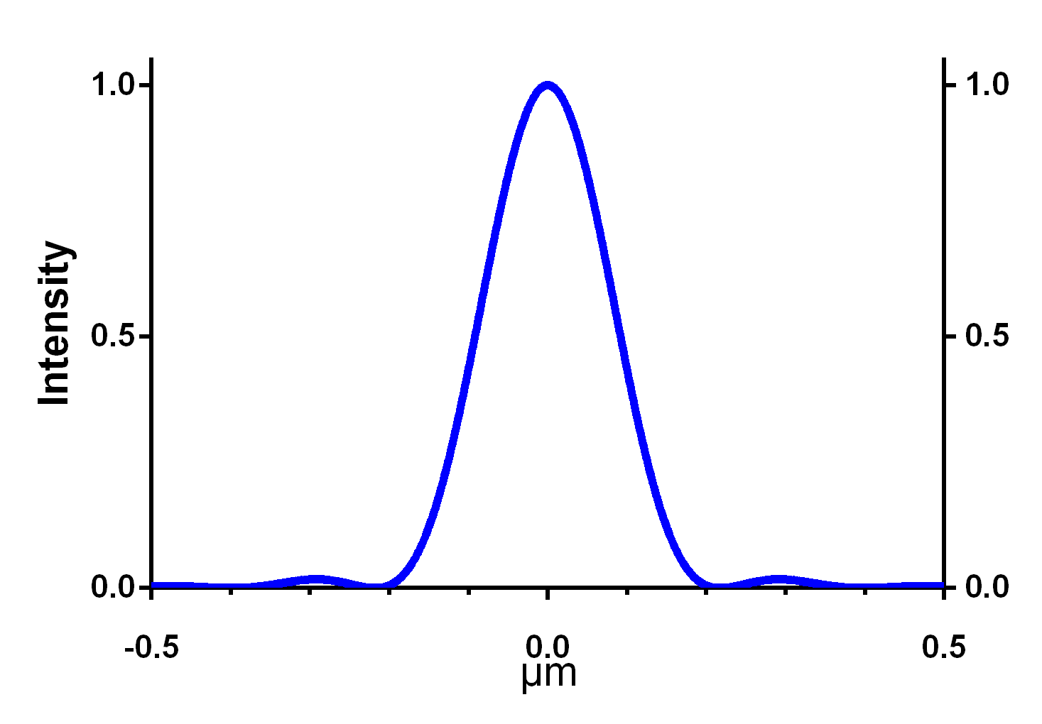

Example: Intensity distribution in the Airy pattern of a point with an NA 1.4 objective with λ=500 nm
217 nm
$r=\frac{0.61∗λ}{NA}=$217 nm

Slide 18
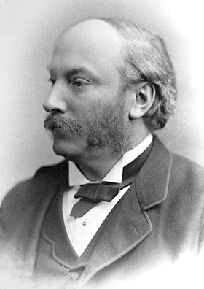

How close can two Airy patterns be together and still be resolved = recognized as two?
Lord Rayleigh
(John William Strutt)
12.11.1842-30.07.1919
Notes:
Source of photography: http://www.nobelprize.org/nobel_prizes/physics/laureates/1904/strutt-facts.html

Slide 19
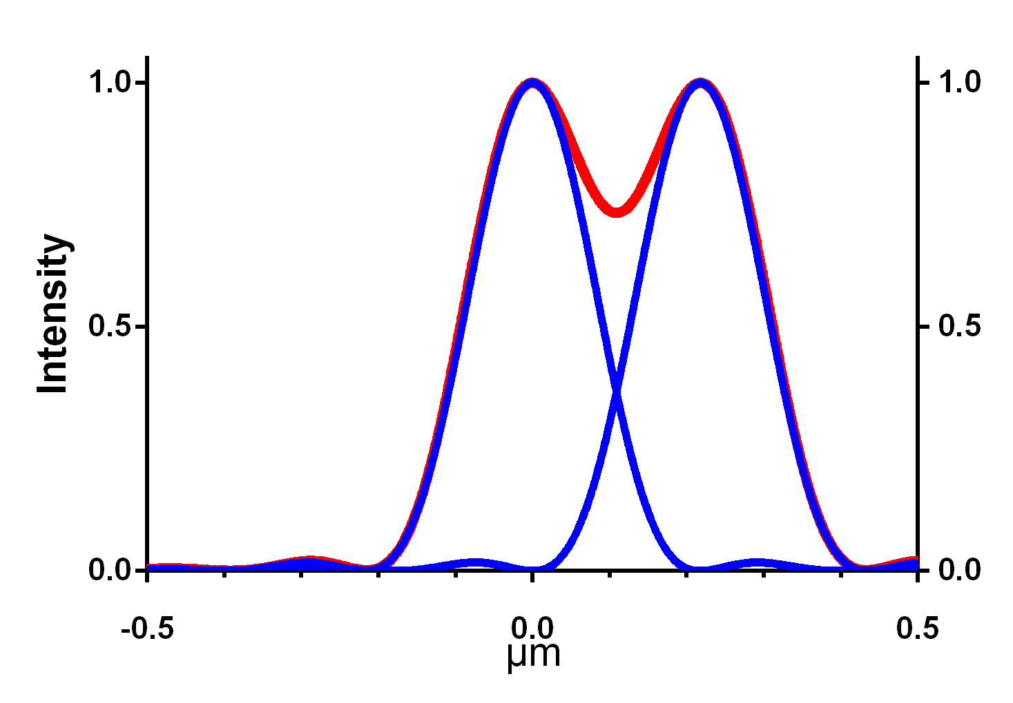
Example: Intensity distribution in the Airy pattern of a point with an NA 1.4 objective with λ=500 nm
26%
Rayleigh criterion

Slide 20
“..This rule is convenient on account of its simplicity; and it is sufficiently accurate in view of the necessary uncertainty as to what exactly is meant by resolution.”
Rayleigh (1879) ‘XXXI. Investigations in optics, with special reference to the spectroscope, Phil. Mag. Series 5,8: 49, p 267
Lord Rayleigh won the Nobel Prize in Physics 1904
"for his investigations of the densities of the most important gases and for his discovery of argon in connection with these studies"
Lord Rayleigh
(John William Strutt)
12.11.1842-30.07.1919

Slide 21
But how do we measure that?
It is very difficult to exactly determine the location of the minimum experimentally
Therefore, for measurements a different criterion is needed:
The Full Width Half Maximum, FWHM

Slide 22

Example: Intensity distribution in the Airy pattern of a point with an NA 1.4 objective with λ=500 nm
FWHM
182 nm
$FWHM=\frac{0.51∗λ}{NA}=$182 nm

Slide 23
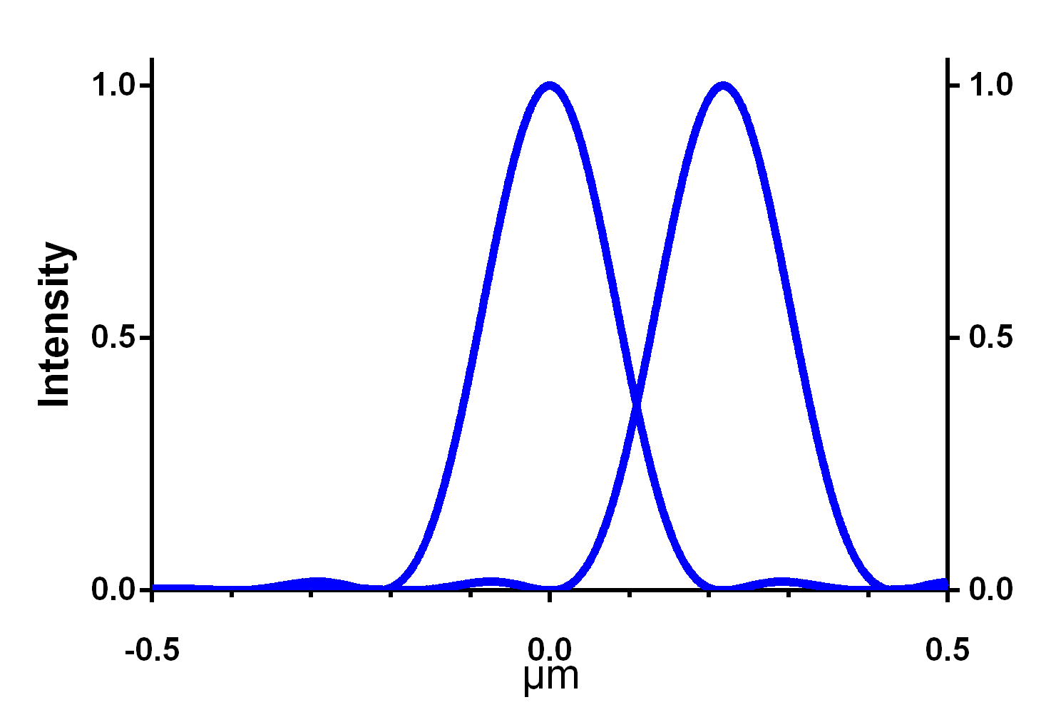
How many pixels do we need?

Slide 24


Slide 25
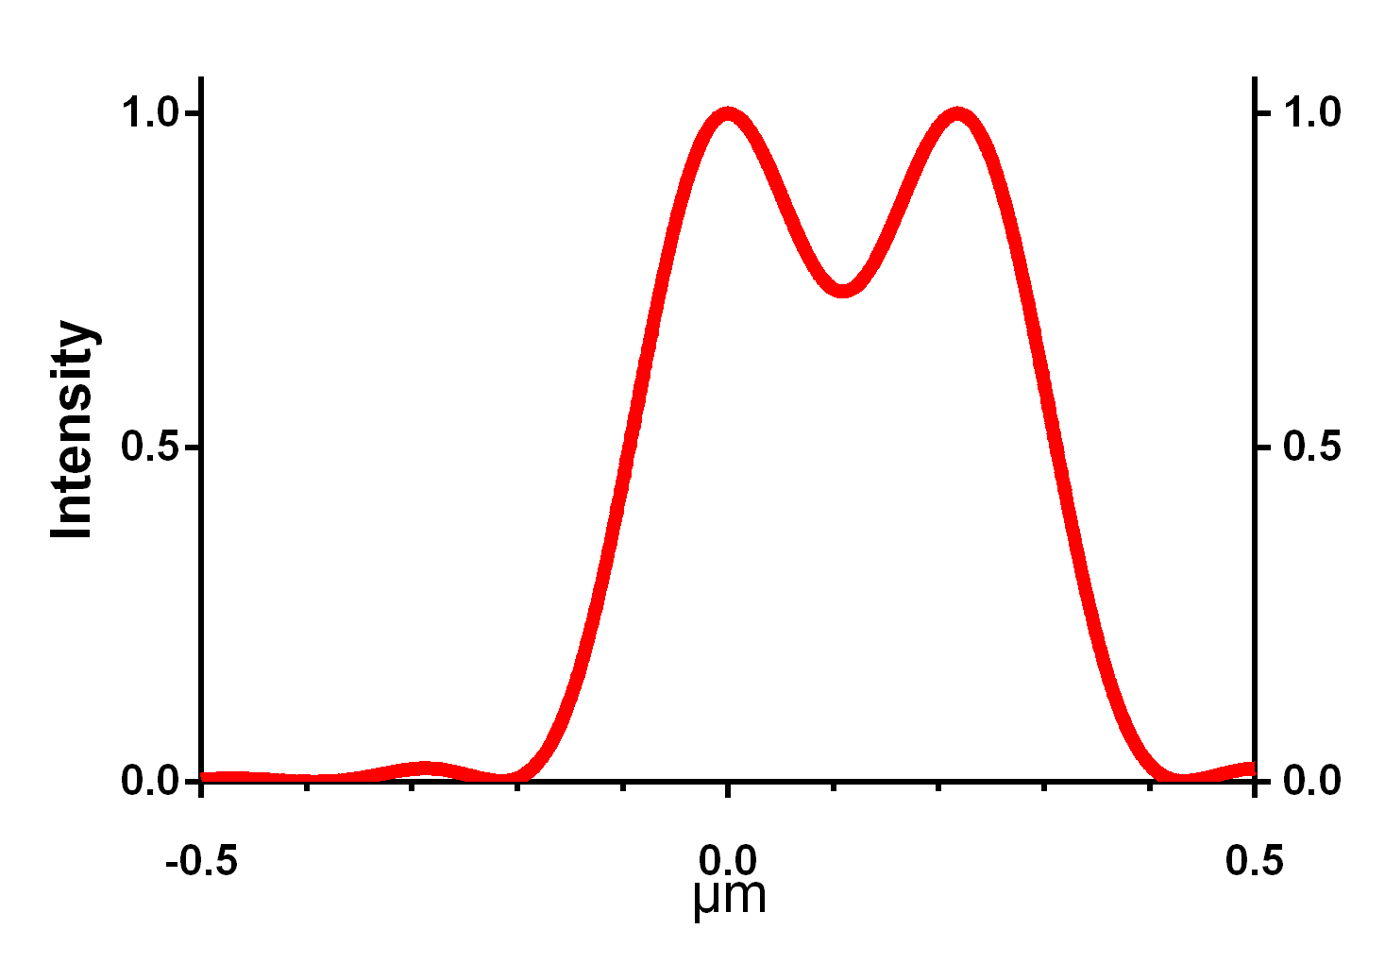
How many pixels do we need?
Pixel size

Slide 26
Which spacing do the pixels have to have?
Pixel size
217 nm

Slide 27
Which spacing do the pixels have to have?
To realize the physical resolution, pixel size must be
< 2x smaller
than the resolution
(Nyquist criterion, after Harry Nyquist, 07.02.1889 - 04.04.1976.)
„< 2x smaller“ is often interpreted as 2.3x smaller.
In the given example that would be 94 nm.
Notes:
According to Steve B. Howell, Handbook of CCD Astronomy, 2nd ed., 2006, page 132 (available on Google Books), critical sampling according to Nyquist is „the sampling interval that is equal to the width (i.e. standard deviation) of the PSF. For a Gaussian PSF this corresponds to a FWHM equal to 2.355 pixels.“

Slide 28
What if the structure is diagonal to the pixel pattern?

Slide 29
Which spacing do the pixels have to have?
Pixel distance at the 45°-angle is √2 = 1.41 times
larger than along the axis.
To cover diagonal point sources, pixel size must be
< 2.82x smaller
than the physical resolution
“< 2.82x smaller” can be interpreted as
1/3 of the resolution.

Slide 30
Which spacing do the pixels have to have?
On the one hand, in real life we don‘t usually reach the theoretical resolution (spherical aberration, etc.), so we could use somewhat larger pixels.
On the other hand, a little oversampling may smoothen the image. Also, we may want to allow for potential confocal resolution improvement, arguing for smaller pixels.
For an NA 1.4 objective, 70 - 80 nm pixel size can be recommended for many cases.
Much smaller pixels do not usually improve image quality but do increase scanning time, bleaching and phototoxicity.

Slide 31
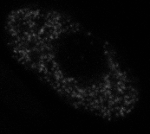
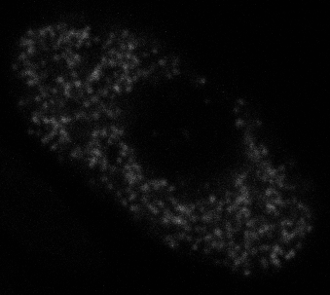
Oversampling: 50 nm or 100 nm px?
100 nm px 50 nm px
. (more exposure)
H2B-GFP-scratch.lif

Slide 32
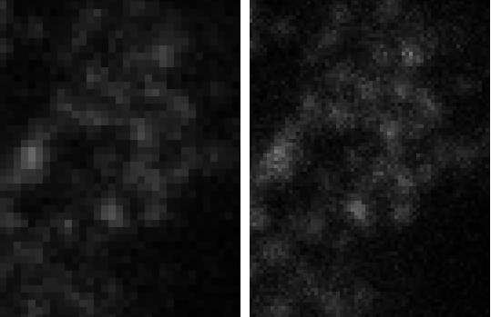
Oversampling: 50 nm or 100 nm px?
100 nm px 50 nm px
. (more exposure)
H2B-GFP-scratch.lif

Slide 33
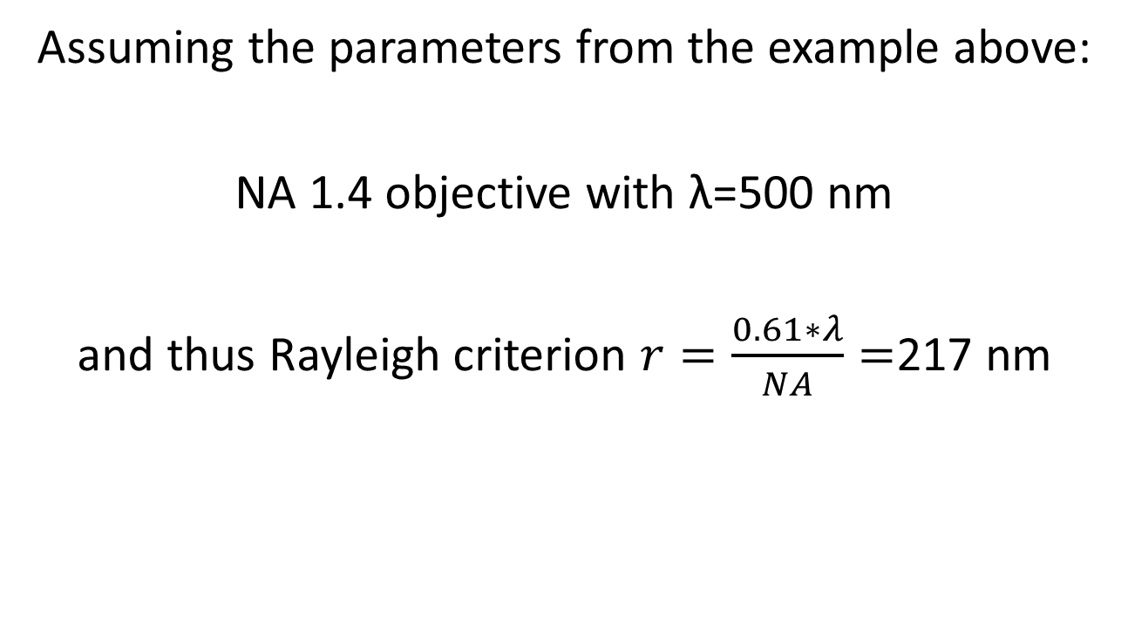
Which intensity difference can we expect for 80 nm pixels in the idealized situation?
Assuming the parameters from the example above:
NA 1.4 objective with λ=500 nm
and thus Rayleigh criterion $r=\frac{0.61∗λ}{NA}=$217 nm

Slide 34
Which intensity difference can we expect for 80 nm pixels in the idealized situation?
80nm
PSF of point 1
+: center of
Airy pattern
+
80nm
PSF of point 2
+
Sum of the two
+

Slide 35
Which intensity difference can we expect for 80 nm pixels in the idealized situation?
80nm
Total Intensity 1 0.62 0.11 0.007
80nm
+ 0.008 0.22 0.79 0.96
= 1.008 0.83 0.90 0.97

Slide 36
Which intensity difference can we expect for 80 nm pixels in the idealized situation?
Total Intensity 1 0.62 0.11 0.007
80nm
+ 0.008 0.22 0.79 0.96
= 1.008 0.83 0.90 0.97
Plot profile along this line

Slide 37
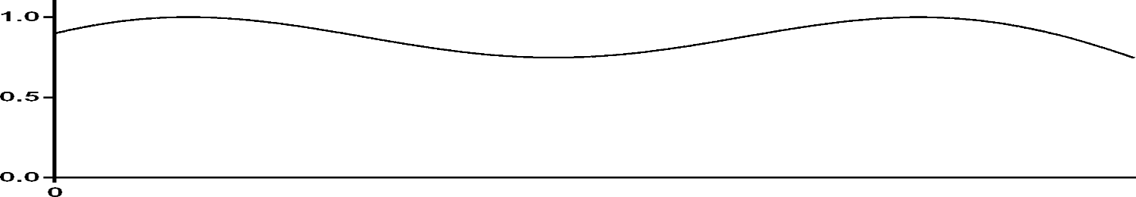
Which intensity difference can we expect for 80 nm pixels in the idealized situation?
Total Intensity 1 0.62 0.11 0.007
80nm
+ 0.008 0.22 0.79 0.96
= 1.008 0.83 0.90 0.97

Slide 38
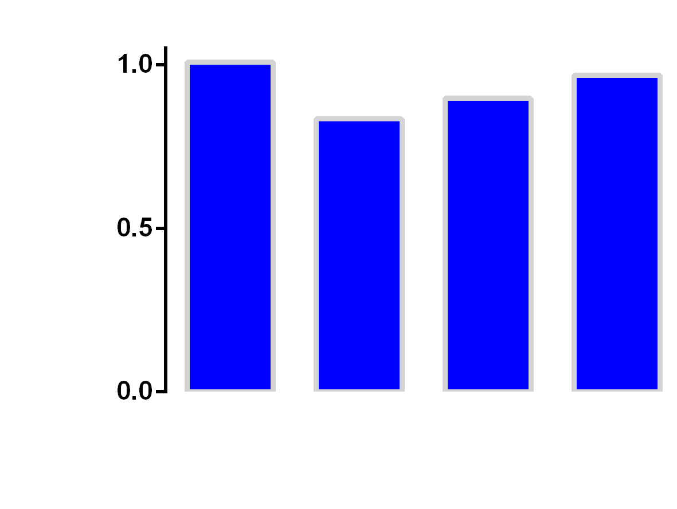
Which intensity difference can we expect for 80 nm pixels in the idealized situation?
for example 202 166 180 194
black, for comparison

Slide 39
Reminder:
This is for the idealized case!
Unlimited number of photons
Two point-like sources emit the same number of photons (identical intensity)
No other sources in the neighborhood
No spherical aberration, Ri mismatch
No noise

Slide 40
Statistical noise
= Poisson noise
= shot noise

Slide 41
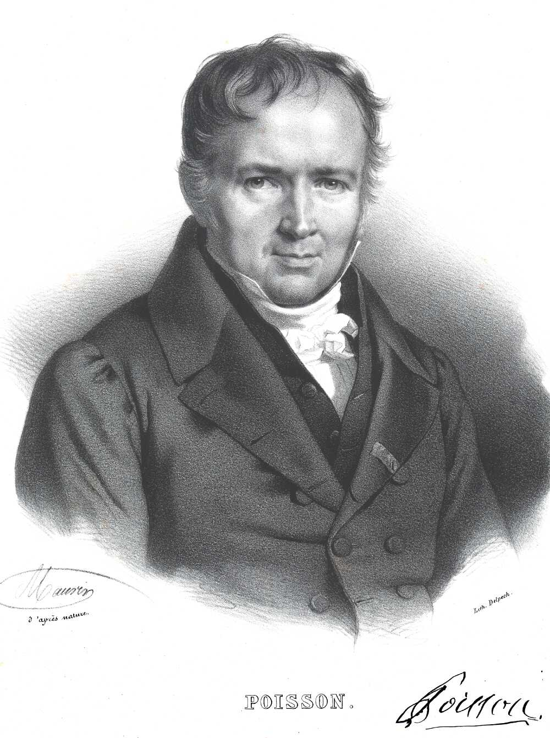
Siméon Denis Poisson
21 June 1781 – 25 April 1840
French mathematician and physicist.
Notes:
Image Source: https://commons.wikimedia.org/wiki/File:SiméonDenisPoisson.jpg

Slide 42
Statistical noise = Poisson noise
Whether any particular fluorescent molecule emits a photon or not is a random, statistical process: Good fluorochromes have a higher probability than bad ones.
Poisson noise is independent of the hardware!
(But hardware may cause other noise).
Notes:
Source: J. B. Pawley: Points, Pixels and Gray levels: Digitizing Image Data. 2006. In: Handbook of confocal biological microscopy, 3rd ed. Chapter 4, p.63

Slide 43
Statistical noise = Poisson noise
…is the square root of the number of photons detected, meaning 2/3 of theoretical photon numbers are within this range.
Example: 16 photons are read (Poisson noise √16=4). 2/3 of such measurements “should have been” between 12 and 20 photons (without noise).
1/3 deviate even stronger.
For 64 photons, the noise is 8.
For 4 photons, the noise is 2.
Notes:
Source: J. B. Pawley: Points, Pixels and Gray levels: Digitizing Image Data. 2006. In: Handbook of confocal biological microscopy, 3rd ed. Chapter 4, p.63

Slide 44
Signal to noise ratio, SNR
Examples
16 photons are read.
Poisson noise √16=4
SNR = 16/4 = 4
64 photons are read.
Poisson noise √64=8
SNR = 64/8 = 8
4 photons are read.
Poisson noise √4=2
SNR = 4/2 = 2
Notes:
Source: J. B. Pawley: Points, Pixels and Gray levels: Digitizing Image Data. 2006. In: Handbook of confocal biological microscopy, 3rd ed. Chapter 4, p.63

Slide 45
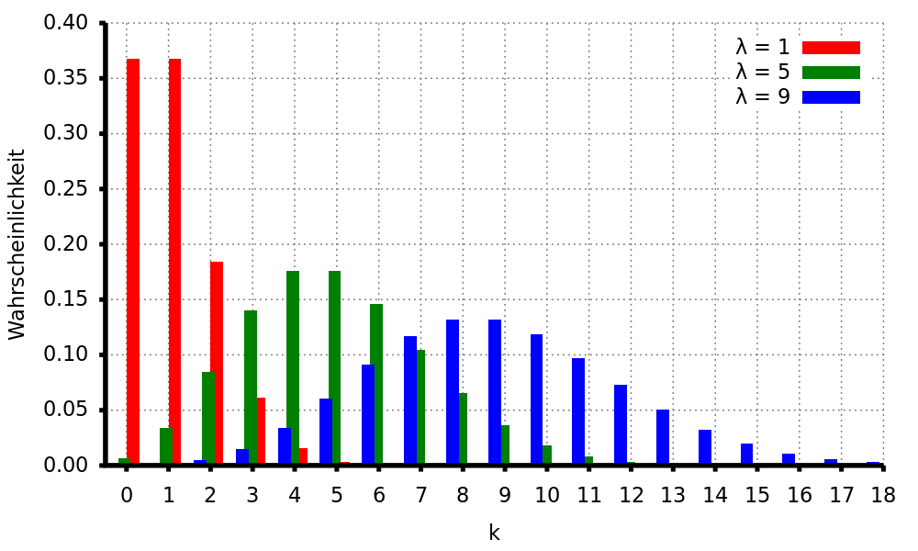
Poisson distribution with 1, 5 and 9
Detected number of photons
probability
“True” number of photons
Image created by StefanPohl and published under a Creative
Commons Public Domain Dedication License. Image source:
https://commons.wikimedia.org/wiki/File:Poisson-Verteilung_1_5_9.svg

Slide 46
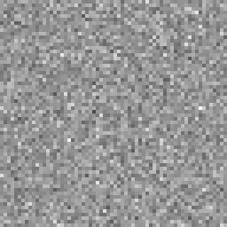
Single scan of a homogeneously fluorescent slide with a hybrid detector
Notes:
64x64 clipping (of a 256x256 image) was scaled up 4x without interpolation in Fiji, to show pixelation. PMT was set to 1000V (of 1250 max), the HyD to “smartGain 100”. Other settings were identical. Recorded on a Leica SP5.

Slide 47
Histogram of a single 256x256 scan of a fluorescent slide
HyD
Number of pixels

Slide 48
Hybrid detectors allow counting of photon (photoelectron) numbers
45
10
50
40
30
1
Notes:
The yellow data refer to the right y-Axis. They are from a fluorescent slide that was strongly tilted on the stage. A z-stack was recorded (256x256x14) to record areas from zero intensity to high intensities. Imaging conditions were identical to the ‘blue’ data, thus the same gray value reflects the same number of photons.

Slide 49

Average Projection of 100 Scans
(frame average) with a hybrid detector
Notes:
64x64 clipping was scaled up 4x without interpolation, to show pixelization. PMT was set to 1000V (of 1250 max), the HyD to “smartGain 100”. Other settings were identical. Recorded on a Leica SP5.

Slide 50
Histogram of a 100x average 256x256 scan of a fluorescent slide

Slide 51
Histogram of a 100x average 256x256 scan of a fluorescent slide
Gray level 148
= 46 photons
From the 100x average we deduce that we should
- in every pixel - get 46 photons

Slide 52
Histogram of a single 256x256 scan of a fluorescent slide
32
64

Slide 53
Histogram of a single 256x256 scan of a fluorescent slide
Example: A pixel has 40 photons.
√40=6.32
SNR = 40/6.32 = 6.32
2/3 of all “true” photon numbers are be between 34 and 47 photons
34
47
32
64

Slide 54
Histogram of a single 256x256 scan of a fluorescent slide
Example: A pixel has 64 photons.
√64=8
SNR = 64/8 = 8
2/3 of all “true” photon numbers are between 56 and 72 photons
32
64

Slide 55
In real life, we are happy if a confocal collects 20 photons for the brightest pixel
for example 202 166 180 194
20 17 18 19
However, the above is not a prediction how such an image will look like.
Rather, it is a probability map. The leftmost pixel simply has a slightly (1.17x) higher probability of receiving a photon than the one right to it.
We might just as well collect the following
In typical settings, we may not be able to collect sufficient photons to be certain of such a small difference.
18 21 20 18

Slide 56
Resolution is not everything,
You also need contrast!
Signal (=number of collected photons) must be above the noise.

Slide 57
Poisson noise, contrast and resolution, demonstrated with a CCD camera
Low light conditions and a USAF 1956 target, brightfield transmission microscopy with a CCD camera. The intensity of the images was adjusted post exposure.
With 3 ms exposure the remaining contrast is just barely sufficient to visualize the larger bars, but not the smaller ones. No bars can be recognized with 1 ms exposure, due to the statistical character of photon detection.
When hundred 1-ms-exposures are averaged, the statistics is good enough to increases the signal-to-noise ratio above the detection limit.

Slide 58
Statistical noise = Poisson noise
Poisson noise is a hard physical limit,
just as diffraction!
Only counting more photons helps!
Notes:
Source: J. B. Pawley: Points, Pixels and Gray levels: Digitizing Image Data. 2006. In: Handbook of confocal biological microscopy, 3rd ed. Chapter 4, p.63

Slide 59
Photon statistics
Only if a large enough number of photons is collected to detect differences in brightness, structures can be resolved.
This fundamentally sets minimal the exposure time and the number of exciting photons.
This is true for all kinds of microscopic image generation. In practice, it plays a role only for fluorescence, since only here too short exposure times are relevant.
Every photon lost in the microscope decreases signal-to-noise ratio, leading to longer exposure times and damage to the sample.

Slide 60
Shot noise = Poisson noise = statistical noise
In a perfect fluorescence microscopy setup, Poisson noise will be the major problem. It can be attenuated by increasing exposure time (camera) or by averaging sequentially recorded images (confocal).

Slide 61
Insufficient image quality can be caused by
Noise
Poisson noise
Electronic detector noise: dark noise and read noise
Blur
Optical aberrations like Ri mismatch, scattering in deep samples, dirty lenses or slides
Unwanted signal (photons)
Unspecific dye binding, autofluorescence in sample or immersion oil, room lights
System or sample variations
Uneven staining, uneven illumination, uneven blur.

Slide 62
File formats, bit depth and compression

Slide 63
Tagged image file format, .tif
Tiff-files may contain just one image or image stacks.
Standard tiff is uncompressed, but compressed versions also exist.
.tif, 8 bit gray scale
.tif, 16 bit gray scale
.tif, color image with 3 channels (RGB), 8 bit each.
.ome.tif, with extra headers for microscopy

Slide 64
How to get a scale bar
From your microscope software, you know the size of one pixel, e.g. 80 nm x 80 nm
Thus, in 10 µm you have 10 µm : 0.08 µm = 125 pixels.
In your image software, draw a box 125 pixels wide (and e.g. 10 px high) for a
10 µm scale bar.

Slide 65
Practice
capture an image
estimate SNR and background level
Determine pixel size with an object micrometer (or graph paper or ruler)
put in a scalebar

