Slide 1
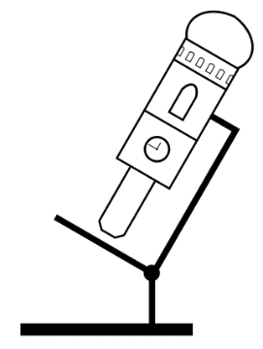

Slides for
Basic Microscope Optics
(BMO)
Steffen Dietzel
Ludwig-Maximilians-Universität München
Walter-Brendel-Zentrum für experimentelle Medizin (Wbex) and
Core Facility Bioimaging at the Biomedical Center

Slide 2
Note 1
This presentation contains material for a lecture on microscopic resolution, specifically in fluorescence microscopy. Therefore, Abbe is not covered but the Rayleigh criterion is.
It is not a complete lecture, nor is it suggested that all slides should be shown in a lecture – there is some redundancy. Some slides - like this one - are ‘hidden’ (won’t show in presentation mode).
The ‘notes’ for each slide may contain links to download source, e.g. for the historic portraits, or other information.
File version July 2016
Notes:
Some slides contain usefull information in this space.

Slide 3
Note 2
This presentation is published on the German BioImaging website.
http://www.germanbioimaging.org
under
Workgroup 5 Training of facility users
German BioImaging is a network of German microscopists and imaging specialists.
And on the website of the Core Facility Bioimaging at the Biomedical Center (BMC) of the Ludwig-Maximilians-Universität München
http://www.bioimaging.bmc.med.lmu.de/learning-teaching

Slide 4
Copyright notice
Except for the logos or if otherwise noted or obviously from other sources, material in this presentation was created by Steffen Dietzel.
Material from Steffen Dietzel is distributed under the license ‘Creative Commons Attribution Sharealike‘. This license includes permission to use, alter and redistribute this material (not limited to but including to students and colleagues), provided you give appropriate credit to the creator (e.g. by leaving the copyright notice at the right lower edge of the slide) and you distribute any derivative work under the same license. For license details see http://creativecommons.org/licenses/by-sa/4.0
The logos (lower and upper right corners of the slides, title slide) are not covered by this license. They may be redistributed with the slides provided in this presentation, but not in a different context.
If you should need a different license for your purpose, please contact me at dietzel@lmu.de

Slide 5
Topics in this file
So far, slides in this file deal with the following topics:
Resolution (Rayleigh, Sparrow, Abbe, FWHM)
Aperture angle, NA and influence on resolution
Immersion
Spherical aberration and coverslip thickness

Slide 6
The idealized situation
Unlimited number of photons
Two point-like sources emit the same number of photons (identical intensity)
No other sources in the neighborhood
No spherical aberration, Ri mismatch
No noise

Slide 7

The image of a point is not a point, but an Airy pattern

Slide 8
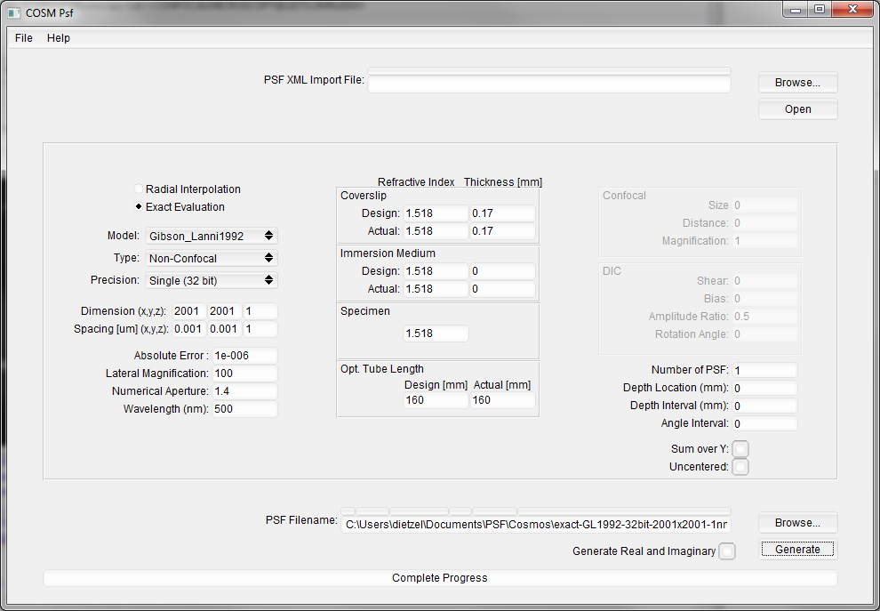
How the Airy patterns and intensity plots in this presentation were created
COSM PSF (http://cirl.memphis.edu/cosmos.php) was used to produce a PSF image (.wu file), see settings in screenshot left. Reassuringly, the first minimum turned out to be at 217 nm away from the Airy pattern maximum, as it should be according to d=0.61*λ/NA.
The .wu image was opened in Fiji (http://fiji.sc/Fiji) using the Import-Raw function with the following parameters: Type 32-real, Offset 1024, Gap 0, Little-endian and the width, height and number of images as defined in COSM PSF.
In Fiji, the image’s type was changed to 16 bit and it was then saved as Text-Image to be reopened in Excel 2013. In the 2001x2001 pixel image, the position of the maximum gray value of 65535 was labeled in Fiji position 1001;1001 and in Excel in Line 1002, Column ALN.
The numbers of line 1002 were then used to draw the “wide-field” diagrams (blue) in GraphPad Prism. For the confocal-with-closed-pinhole diagram (green), the numbers of this line were squared.
For import in Powerpoint, images of Airy patterns in Fiji were first adjusted to the desired grayscale range and then converted to 8-bit,
For images with the ‘added pixel intensities’ (see right), 80x80 pixel (=nm) sized boxes were defined in Fiji (y-value for all: 961. x-values: 961, 1041, 1121, 1201, 938, 1018, 1098, 1178). Two images were added using the “Calculator Plus” (k1=0.5; k2=0). All 12 ‘pixel-’images were combined in a stack to create the montage shown here. The average intensity was determined using the ‘measure’ command. Values were normalized in Excel.
One exception applies: The image with two neighboring Airy patterns was created by Katharina Nekolla with Matlab code kindly provided by Peng Xi. This code is published in his book “Optical Nanoscopy and Novel Microscopy Techniques" published by CRC.
I would like to thank the contributors to the ‘confocal list’ (http://lists.umn.edu/cgi-bin/wa?A0=CONFOCALMICROSCOPY). Without the tips of Arne Seitz, Sergey Tauger, David Baddeley, Peng Xi and others, I would have not been able to generate those images.

Slide 9
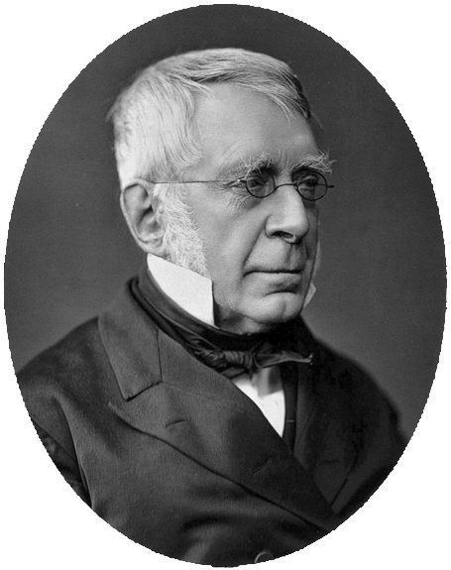
The image of a point is not a point, but an Airy pattern
Sir George Biddell Airy,
27.07.1801–02.01.1892
Astronomer Royal 1835-1881
Notes:
Source of photography: http://wellcomeimages.org/indexplus/image/V0025959.html
Via https://commons.wikimedia.org/wiki/File:George_Biddell_Airy2.jpg

Slide 10
Intensity profile
measured along this line

Slide 11
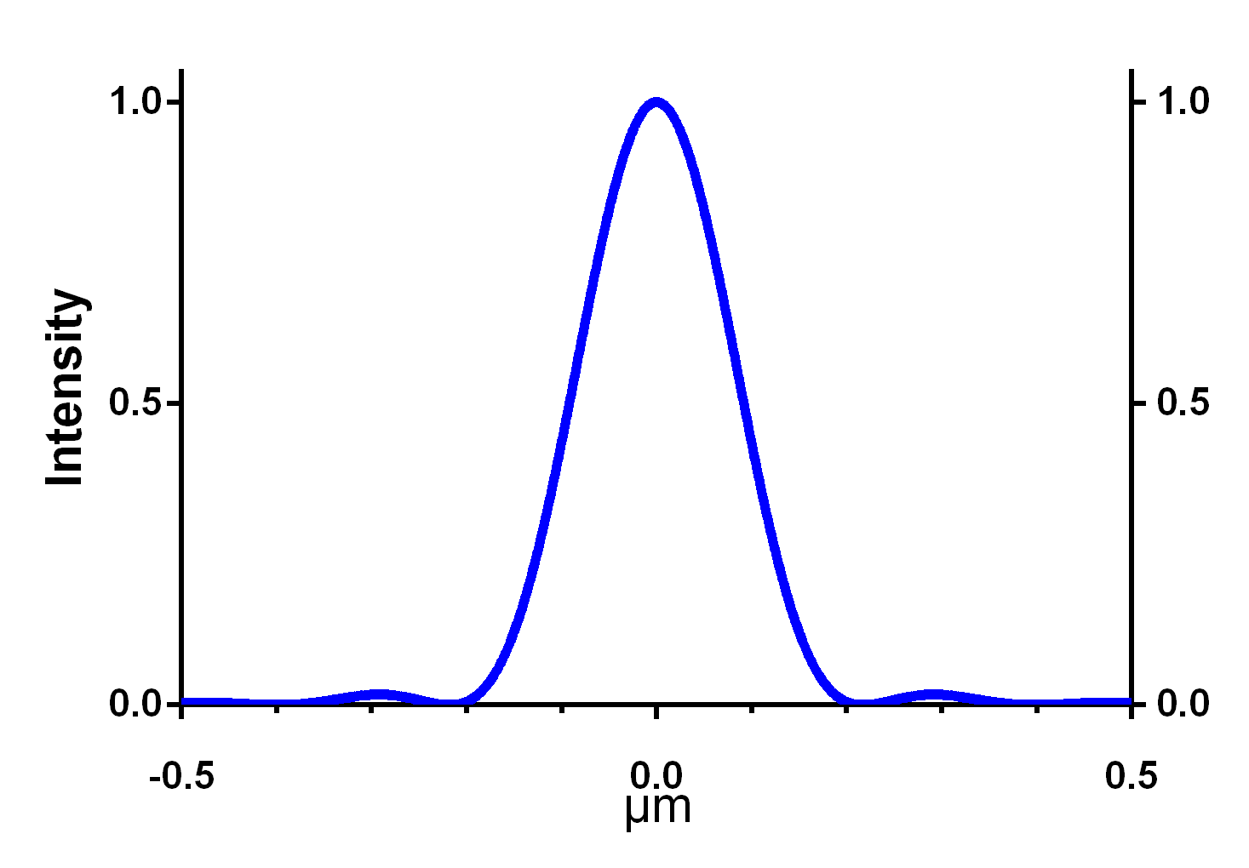

Example: Intensity distribution in the Airy pattern of a point with an NA 1.4 objective with λ=500 nm
217 nm
$r=\frac{0.61∗λ}{NA}=$217 nm

Slide 12
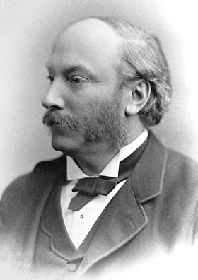

How close can two Airy patterns be together and still be resolved = recognized as two?
Lord Rayleigh
(John William Strutt)
12.11.1842-30.07.1919
Notes:
Source of photography: http://www.nobelprize.org/nobel_prizes/physics/laureates/1904/strutt-facts.html

Slide 13
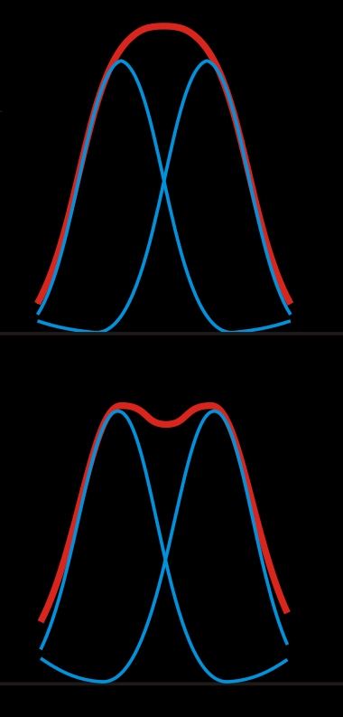
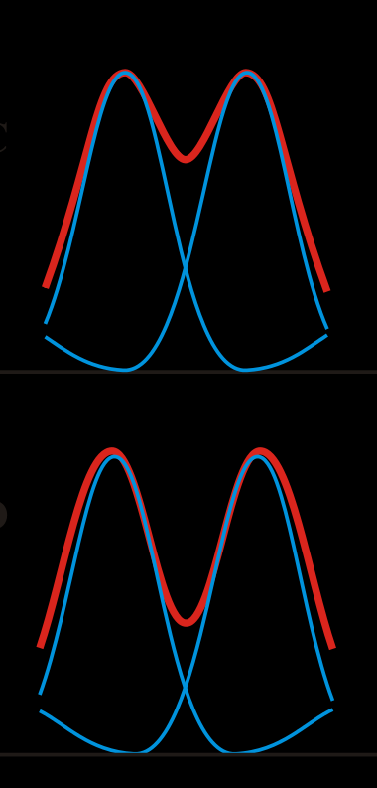
1
2
3
4
Rayleigh limit
Sparrow limit
Image creator: Mpfitz, Public Domain
https://upload.wikimedia.org/wikipedia/commons/thumb/6/61/RayleighCriterion.svg/500px-RayleighCriterion.svg.png

Slide 14
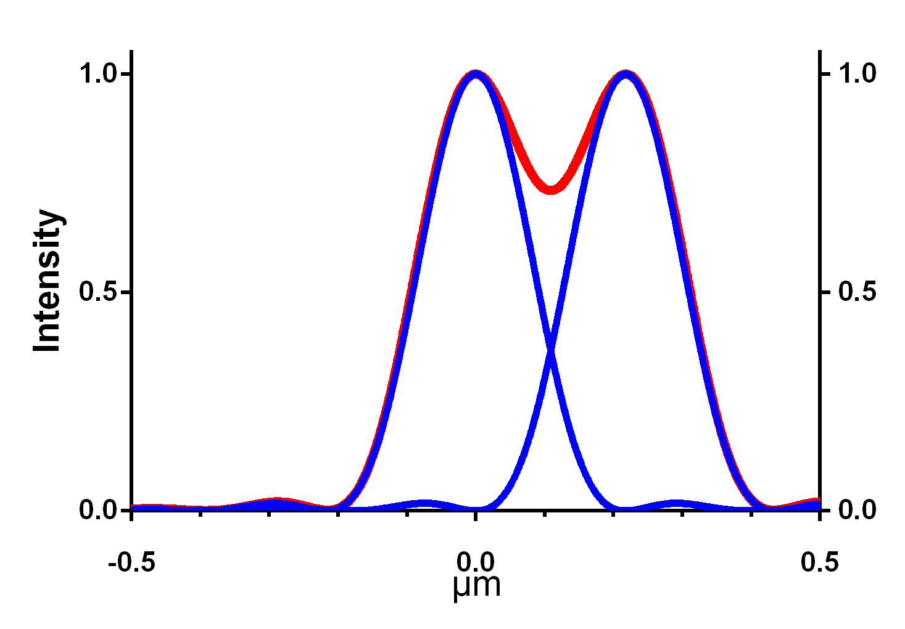
Example: Intensity distribution in the Airy pattern of a point with an NA 1.4 objective with λ=500 nm
26%
Rayleigh criterion

Slide 15
“..This rule is convenient on account of its simplicity; and it is sufficiently accurate in view of the necessary uncertainty as to what exactly is meant by resolution.”
Rayleigh (1879) ‘XXXI. Investigations in optics, with special reference to the spectroscope, Phil. Mag. Series 5,8: 49, p 267
Lord Rayleigh won the Nobel Prize in Physics 1904
"for his investigations of the densities of the most important gases and for his discovery of argon in connection with these studies"
Lord Rayleigh
(John William Strutt)
12.11.1842-30.07.1919

Slide 16
But how do we measure that?
It is very difficult to exactly determine the location of the minimum experimentally
Therefore, for measurements a different criterion is needed:
The Full Width Half Maximum, FWHM

Slide 17

Example: Intensity distribution in the Airy pattern of a point with an NA 1.4 objective with λ=500 nm
FWHM
182 nm
$FWHM=\frac{0.51∗λ}{NA}=$182 nm

Slide 18
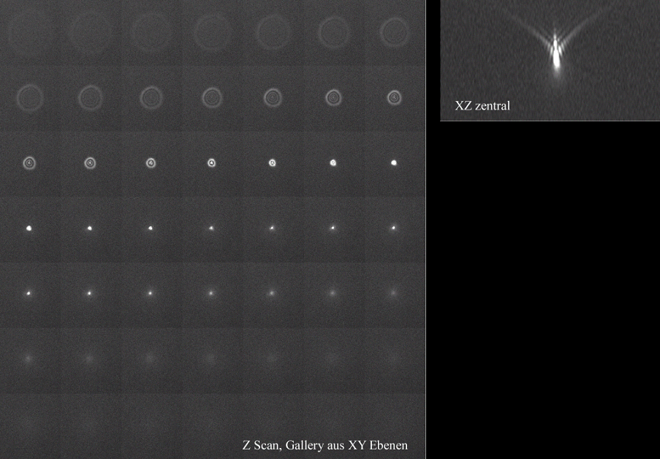
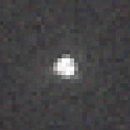
How to measure the FWHM of a Point-spread-function
Z-sections through a 175 nm bead
PSF widefield microscope,
175 nm bead Cy3

Slide 19
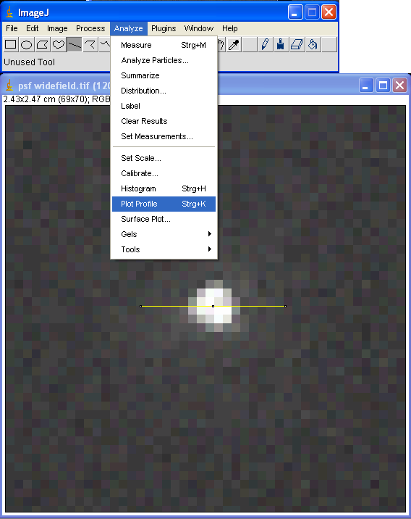
With Fiji or ImageJ

Slide 20
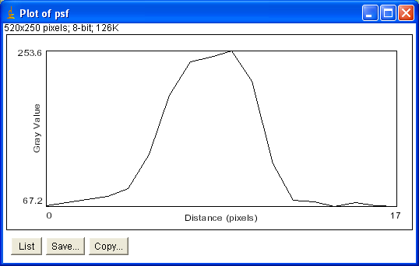
Intensity distribution along the line selection
X-axis: Pixels
Y-axis: Intensity (gray level)

Slide 21
Maximum
Half-Maximum
FWHM
FWHM: Full width of half maximum
Minimum

Slide 22
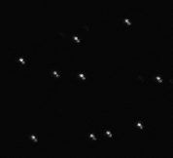
Shit does happen!
Leica SP1, 63x,
with DIC Prism in the beam path

Slide 23
Test your microscope!
Record point spread function (PSF) for every color channel you plan to use.
For immersion objectives, use 175 nm or smaller beads (e.g. from Molecular Probes) or individual quantum dots.
Measure the Full width half maximum (FWHM) of the PSF (e.g. with ImageJ).
Do this measurement a couple of times and average the result.
Some objectives are good only in the center, so test in center and near the edge of field of view
Theory: FWHM_{x,y}=0.51*λ/NA

Slide 24
All this was about imaging in the focal plane – what about z?

Slide 25
The Airy pattern in z-direction

Slide 26
The Airy pattern in z-direction

Slide 27
The Airy pattern in z-direction
Cut here

Slide 28
The Airy pattern in z-direction

Slide 29
Example: Intensity distribution in the Airy pattern of a point with an NA 1.4 objective with λ=500 nm
Z-direction

Slide 30
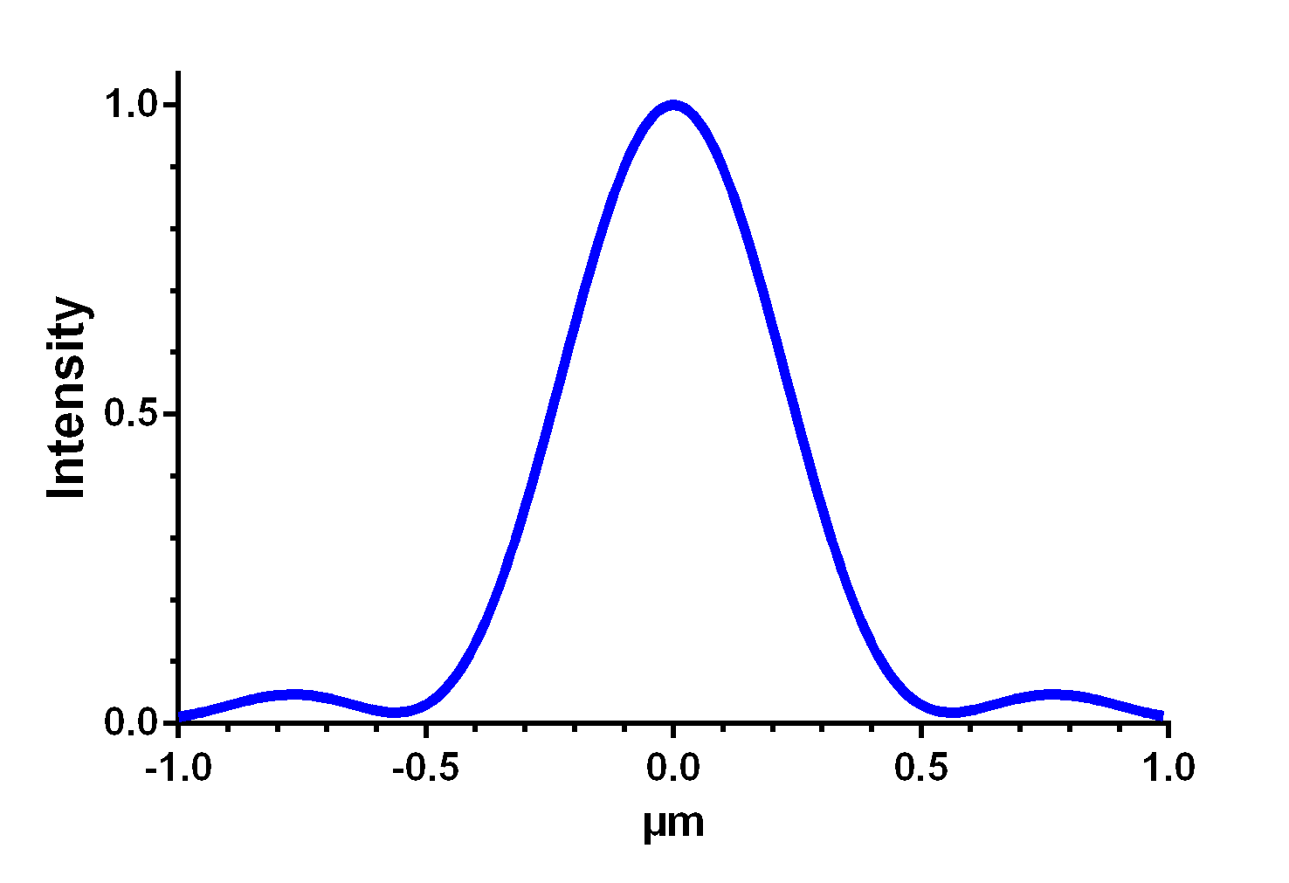
Example: Intensity distribution in the Airy pattern of a point with an NA 1.4 objective with λ=500 nm
Z-direction

Slide 31
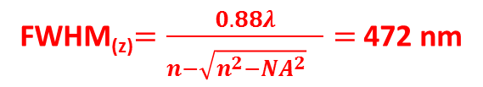
Example: Intensity distribution in the Airy pattern of a point with an NA 1.4 objective with λ=500 nm
Z-direction
FWHM_{(z)}$=\frac{0.88λ}{{n−\sqrt{n^{2}−{NA}^{2}}}^{}}=$ 472 nm
Notes:
In this graph (computed in CosmPSF with 10 nm steps) the half maximum z is actually at -0.25 µm and 0.25 µm, the FWHM in this graph is therefore 0.49.

Slide 32
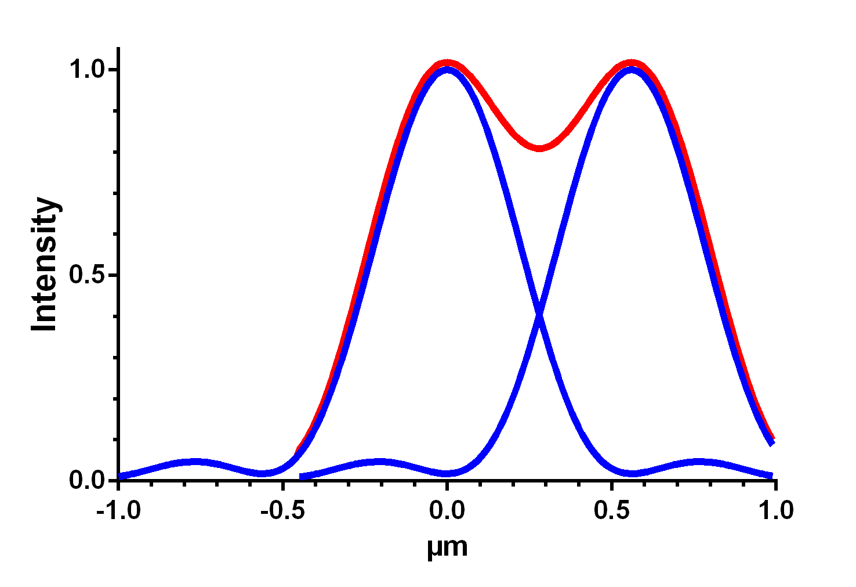
Example: Intensity distribution in the Airy pattern of a point with an NA 1.4 objective with λ=500 nm
Z-direction

Slide 33
Rayleigh criterion
The Rayleigh criterion is a good criterion for self-luminous objects such as in fluorescence microscopy.
For brightfield (‘non-fluorescence’) microscopy the Abbe-limit is more appropriate (but we don’t go into that)
In the focal plane, ΔR = 0.61•λ / NA

Slide 34
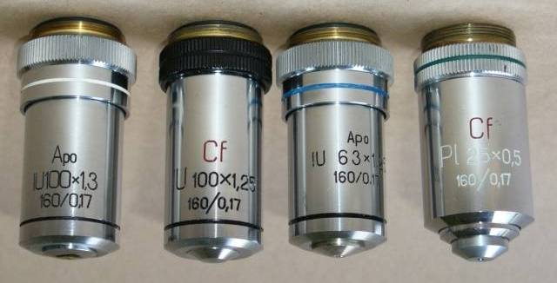
What is NA?
Numerical Apertur
Given on every professional objective
Range: about 0.04 – 1.45
ΔR = 0.61•λ / NA
http://commons.wikimedia.org/wiki/File:Objektiv2.jpg
Creator: Szőca TamásTamasflex, Creative Commons Attribution-Share Alike 3.0 Unported

Slide 35
The aperture angle or acceptance angle
(German: Öffnungswinkel)

Slide 36

The aperture angle of the objective
With a larger acceptance angle of the front lens, additional diffraction rings will contribute to the image
In particular, for some strongly diffracting (i.e. small) objects, the first maximum is now collected, which is otherwise missed
=> Better resolution is achieved.

Slide 37
Ernst Abbe, 1873:
„durch kein Mikroskop können Teile getrennt (oder die Merkmale einer real vorhandenen Struktur wahrgenommen) werden, wenn dieselben einander so nahe stehen, dass auch der erste durch Beugung erzeugte Lichtbüschel nicht mehr gleichzeitig mit dem ungebeugten Lichtkegel in das Objektiv eintreten kann“.
No microscope can separate parts (or properties of an existing structure), if they are so close to each other, that even the first ring maximum generated by diffraction will not enter the objective together with the undiffracted light.
http://www.zeiss.de/C1257173002D0F60/0/06AF63BB52D85C74C1257185003F8553/$File/Innovation_15_18.pdf

Slide 38
Aperture Angle and NA
The aperture angle is 2α
Definition: Numerical Aperture
NA = n • sinα
Resolution = 0.61• λ / NA
= 0.61• λ /(n• sinα)
Refractive Index
α

Slide 39
Why is the refractive index important for resolution?
But let‘s have some examples first

Slide 40
Examples
NA = n • sinα
4x air objective NA = 0.16
0.16 = 1 • sinα, α = 9.2°
aperture angle 2α = 18,4°
100x oil objective NA = 1.4
1.4 = 1.518 • sinα
sinα = 0.92 , α = 67°
aperture angle 2α = 134°

Slide 41
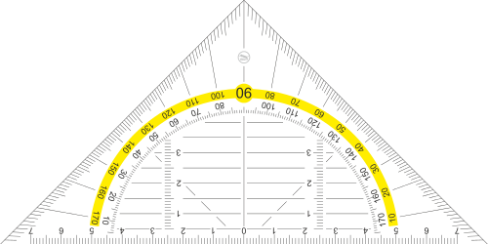
Examples
18.4°
134°
This is in 3D!

Slide 42
Take-home-message:
Higher NA means
better resolution
and
more light

Slide 43
Why is the refractive index (Ri) important for resolution?
The Ri of the medium between coverslip and objective, that is.

Slide 44
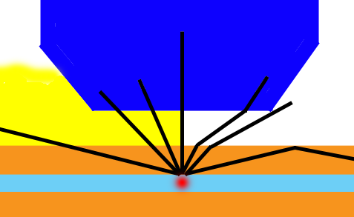
Oil immersion has better resolution because light from a larger angle (=more information) is collected
Optical density (refractive index = Ri) of oil is similar but not identical to glass
Notes:
Path of rays with immersion medium (yellow) (left half) and without (right half). Rays (black) coming from the object (red) at a certain angle and going through the coverslip (orange, as the slide at the bottom) can enter the objective (dark blue) only when immersion is used. Otherwise, the refraction at the coverslip - air interface causes the ray to miss the objective and its information is lost.

Slide 45
Maximal NA
The theoretical maximum for the opening angle 2α is 180° (if the diameter of the front lens is infinite and the working distance 0.) For NA = n • sinα then applies:
Dry objectives:
NA = 1 • sin (90°) = 1
Actual values are at most at 0.95, reflecting an opening angle of 2x72°.
Oil objectives:
NA = 1.518 • sin (90°) = 1.518
Actual values are at most at 1.45.

Slide 46
Maximal resolution with todays normal fluorescence microscopes
(Rayleigh criterion)
Resolution = 0.61• λ / NA
for a NA=1.4 Oil immersion objective:
Maximal theoretical resolution in xy
for λ = 500 nm:
d₀ = 0.61 x 500 nm / 1.4 = 217 nm
For λ = 450 nm: d0 = 196 nm
For λ = 700 nm: d0 = 305 nm

Slide 47
Embedding medium and coverslips
–
Why you shouldn‘t just take what you find in some drawer

Slide 48
Oil immersion has better resolution because light from a larger angle (=more information) is collected

Slide 49
Ri mismatch
Oil immersion objectives are made to be used with oil on both sides of the coverslip.
Scientists don‘t usually embed their preparations in oil.
So, we get an Ri mismatch
Similar if you use a coverslip with a dipping water objective.

Slide 50
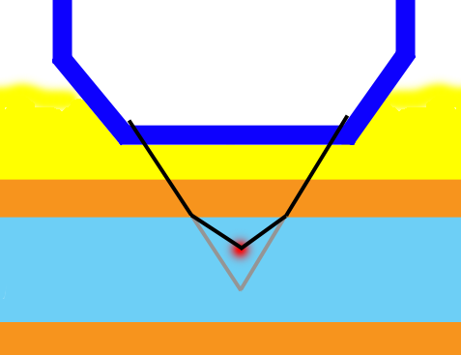
Ri mismatch
Consequence 1: The focus you are looking at is not where the microscope (software) tells you it is.
Example: Oil objective but cells are in water: You are only 8.2 µm away from the coverslip instead of 10.
oil
coverslip
water
actual focal position
nominal focal position
focal shift

Slide 51
Ri mismatch
Hell SW, Stelzer EHK: Lens aberrations in confocal fluorescence microscopy. In: Handbook of biological confocal microscopy. 2nd edition. Edited by Pawley JB. New York: Plenum Press; 1995: 347-354.
Notes:
On this slide, the following figures are missing for copyright reasons: Figure 8 and 9 from: Hell SW, Stelzer EHK: Lens aberations in confocal fluorescence microscopy. In: Handbook of biological confocal microscopy. 2nd edition. Edited by Pawley JB. New York: Plenum Press; 1995: 347-354. In the 3rd edition, Fig. 8 is replaced by figures 20.09 and 20.10.
Fig. 8 shows the focal shift for Ri 1.33 to Ri 1.49 in the medium, Fig 9 shows actual focal position vs. nominal FP for oil, water and glycerol.

Slide 52
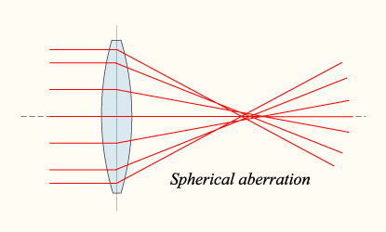
Ri mismatch
Consequence 2: The resolution goes down dramatically with depth, due to uncorrected spherical aberration.
For distances from the coverslip > 20 µm don‘t use an oil immersion objective with a sample in water (or glycerol, respectively).
Which is why cultured cells should always be on the coverslip, not on the slide.
Image source:
https://commons.wikimedia.org/wiki/File:Lens-sphericalaberration.png
Created by DrBob and published under CC BY-SA 3.0

Slide 53
Ri mismatch
Consequence 3: The brightness goes down dramatically with depth, due to uncorrected spherical aberration.
Which is why you should care even if you don‘t need a good resolution.

Slide 54
Are you in trouble with your preparation?
Find out with self-made test slides:
Coverslips with dried-on fluorescent beads (or Qdots)
Object slides with dried on fluorescent beads.
Make several test preparations with variable amounts of that old mounting medium you found in some fridge. This leads to a variable distance beteween coverslip and slide.
Measure and compare FWHM and brightness of beads on coverslip with those on slides in variable depths.

Slide 55
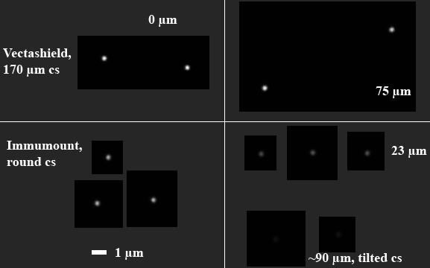

Slide 56
z-direction
x, y-direction
Notes:
This slides shows the FWHM under variable conditions (colors and shapes), depending on the distance to the coverslip. All FWHMs are fine at the coverslips. With increasing depth, under some conditions the FWHM deteriorates stronger than under others. Mounting media: Vectashield, Immumount, Permafluor. Please note that the number of measurements is insufficient for definite conclusions. This slide is merely ment to show a general trend.

Slide 57
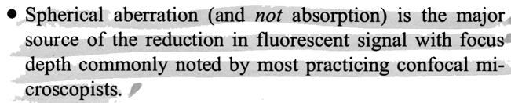
Intensity drop with depth
Citation from: Hell SW, Stelzer EHK: Lens aberrations in confocal fluorescence microscopy. In: Handbook of biological confocal microscopy. Edited by Pawley JB. New York: Plenum Press; 1995: 347-354.
Intensity:
Oil objective with Oil Oil objective with glycerol Oil objective with water
Notes:
On this slide, the following figures are missing from the lower part for copyright reasons: Figures 5, 6 and 7 from: Hell SW, Stelzer EHK: Lens aberrations in confocal fluorescence microscopy. In: Handbook of biological confocal microscopy. 2nd edition. Edited by Pawley JB. New York: Plenum Press; 1995: 347-354. In the 3rd edition, they replaced by figures 20.06, 20.07 (left half) and 20.8.

Slide 58
Consequences of Ri mismatch
Ri mismatch with increasing depth is less of a problem with low NA objectives.
Therefore, if no appropriate objective is available, for Ri mismatch conditions and deep imaging, rather use a low NA objective.
“On the other hand, imaging through a 20-µm layer of water gives about the same image with either lens [NA 1.4 or 0.8 oil], and any features closer to the coverslip will be imaged better by the larger NA lens”. Cited from: Hell SW, Stelzer EHK: Lens aberrations in confocal fluorescence microscopy. In: Handbook of biological confocal microscopy. 2nd ed. Edited by Pawley JB. New York: Plenum Press; 1995: 347-354.

Slide 59
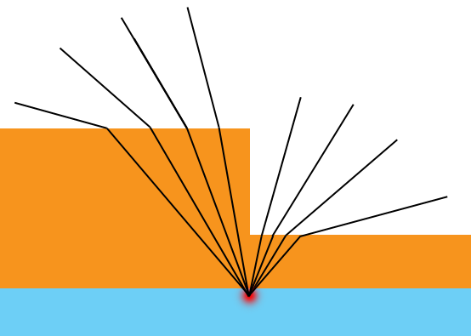
Coverslip thickness
To avoid uncorrected spherical aberration, the coverslip must have the right thickness!
expected beam path
unexpected beam path

Slide 60
Coverslip thickness
The right thickness is 170 µm. This is what microscopy companies have their objectives designed for.
Unfortunately, this is not what you usually get.
http://commons.wikimedia.org/wiki/File:Objektiv2.jpg
Creator: Szőca TamásTamasflex, Creative Commons Attribution-Share Alike 3.0 Unported

Slide 61
Coverslip thickness
Problems are even worse with water immersion or dry objectives with high N.A.
If you want to do high resolution microscopy, you must use 170 µm coverslips, (“Thickness 1½ “ or better).
Unfortunately these are not so easy to find: Most normal lab suppliers do not carry them. We use the ones from www.hecht-assistent.de

Slide 62
Coverslips
Some objectives („Corr“) have correction collars with which they can be adapted to varying coverslip thicknesses.
Some can handle 0-2 mm.

